Slide 1
SKILL TRACKER USE CASE
HARSHIT LNU
(2153360)

Slide 2
USE CASE
INTRODUCTION
Skill Tracker Application is Spring boot MVC based Application.
The main purpose of Skill Tracker is to track skills of individual user.
IMPORTANT APIs
Implemented below API:
Authentication API (Log in & log out API’s).
Create Profile API.
Delete profile API
Update Profile API.
View Profile API.
2
© 2022 Cognizant | Confidential or Trade Secret

Slide 3







TECHSTACK
SKILL STACK | TECHNOLOGIES
FRONT END
BACK END
DATABASE
3
© 2022 Cognizant | Confidential or Trade Secret

Slide 4
PLANNED ARCHITECTURE
Client
Postman
UI
API Layer
Service Layer
Authentication
Database
MySQL
Create Profile
Update Profile
Delete Profile
View Profile
CQRS design pattern
update Profile
Delete Profile
4
© 2022 Cognizant | Confidential or Trade Secret

Slide 5
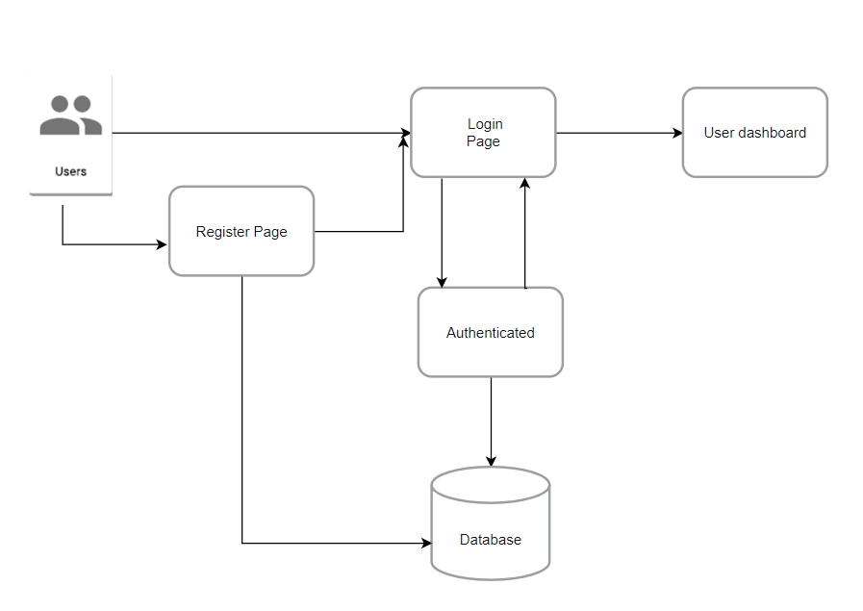
AUTHENTICATION FLOW
User Register in registration page.
User login to the landing page.
After validation, It sends request to Authentication Services.
There it is verified and saved in DB.
Success and error message is sent to the UI from the server.
If user successfully login in it
It will redirect to dashboard page
© 2022 Cognizant | Confidential or Trade Secret

Slide 6
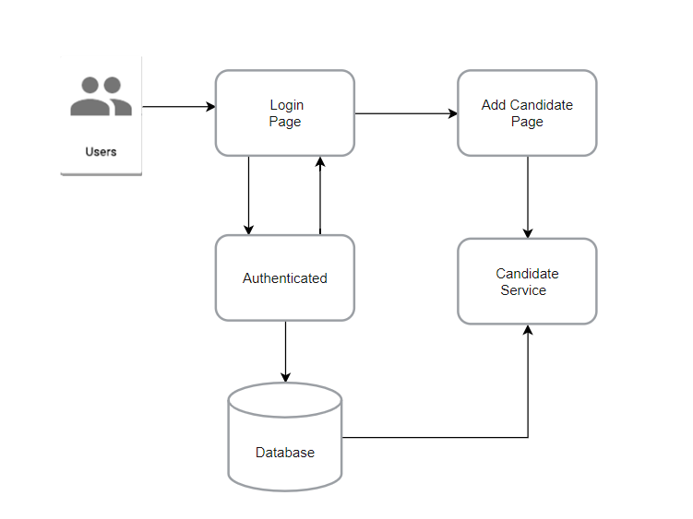
INITIAL DESIGN FOR CREATE PROFILE FLOW
User is authenticated from these steps .
UI redirects to add candidate page.
Skills are added in add profile page.
It gets validated and saved in database.
6
© 2022 Cognizant | Confidential or Trade Secret

Slide 7
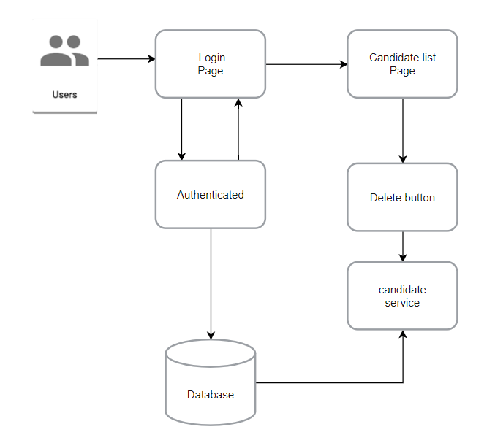
INITIAL DESIGN FOR DELETE PROFILE FLOW
User is authenticated from step 1-4.
UI redirects to candidate list page.
Click on update button in candidate list page.
Candidate service is called
It gets validated and saved in database.
7
© 2022 Cognizant | Confidential or Trade Secret

Slide 8
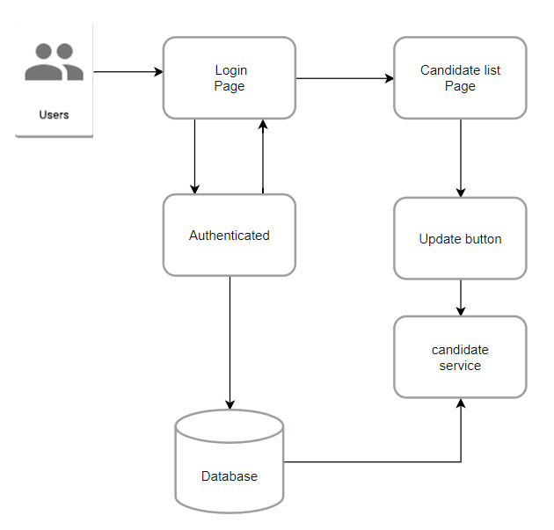
INITIAL DESIGN FOR UPDATE PROFILE FLOW
User is authenticated from step 1-4.
UI redirects to candidate list page.
Click on delete button in candidate list page.
Candidate service is called
It gets validated and saved in database.
8
© 2022 Cognizant | Confidential or Trade Secret

Slide 9
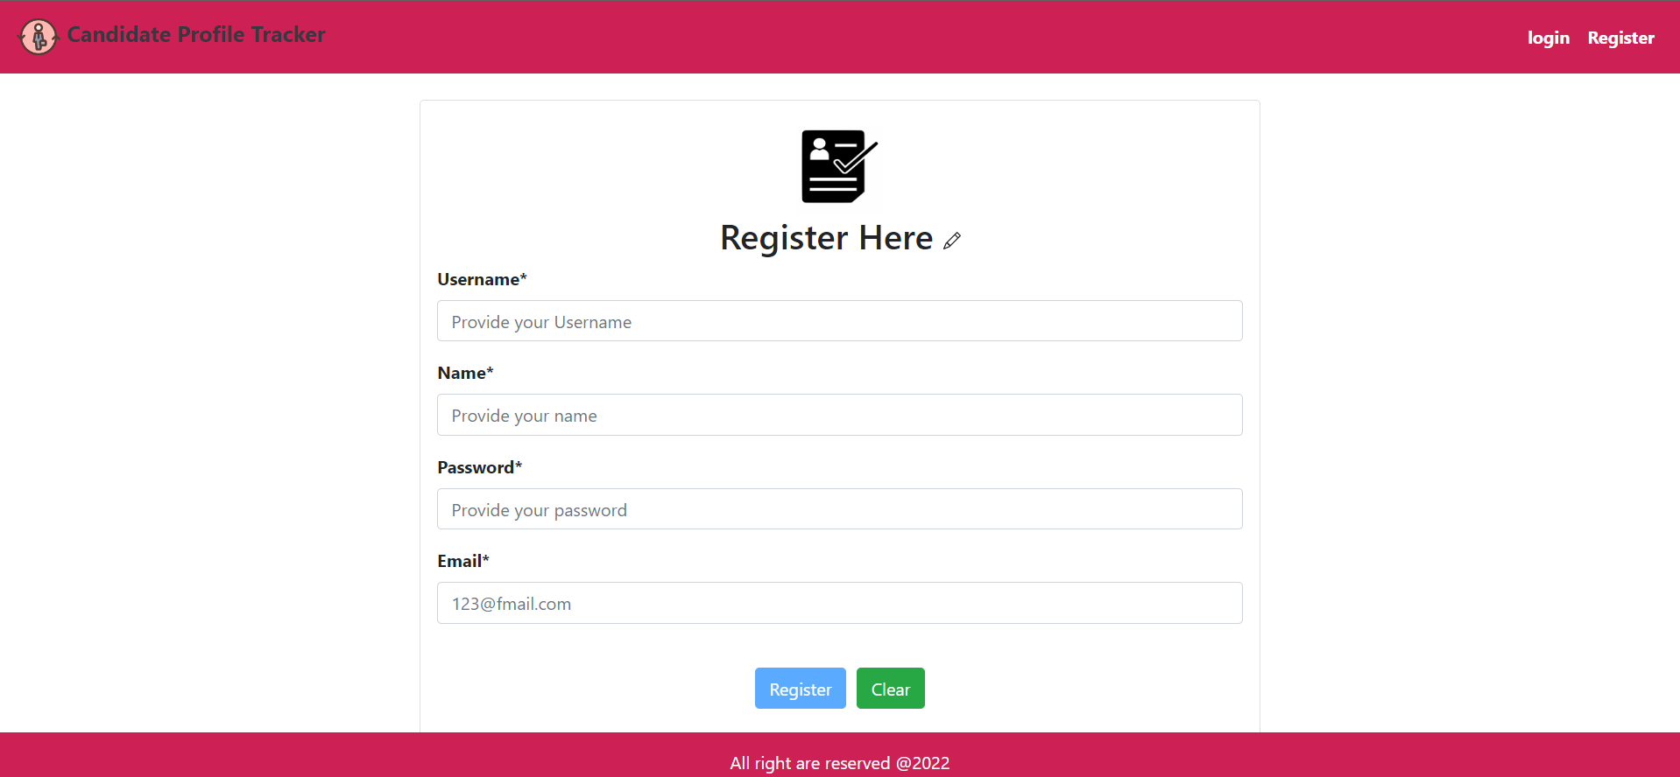
SIGNUP FORM UI
FIELD | CONDITION
Username | Must be alphabet either accept lower case or upper case
Password | Encrypted and applied pattern validations on these field.
Email | Valid email pattern, containing a single @
Name | Must start with alphabet and not null
MANDATORY FIELD
9
© 2022 Cognizant | Confidential or Trade Secret

Slide 10
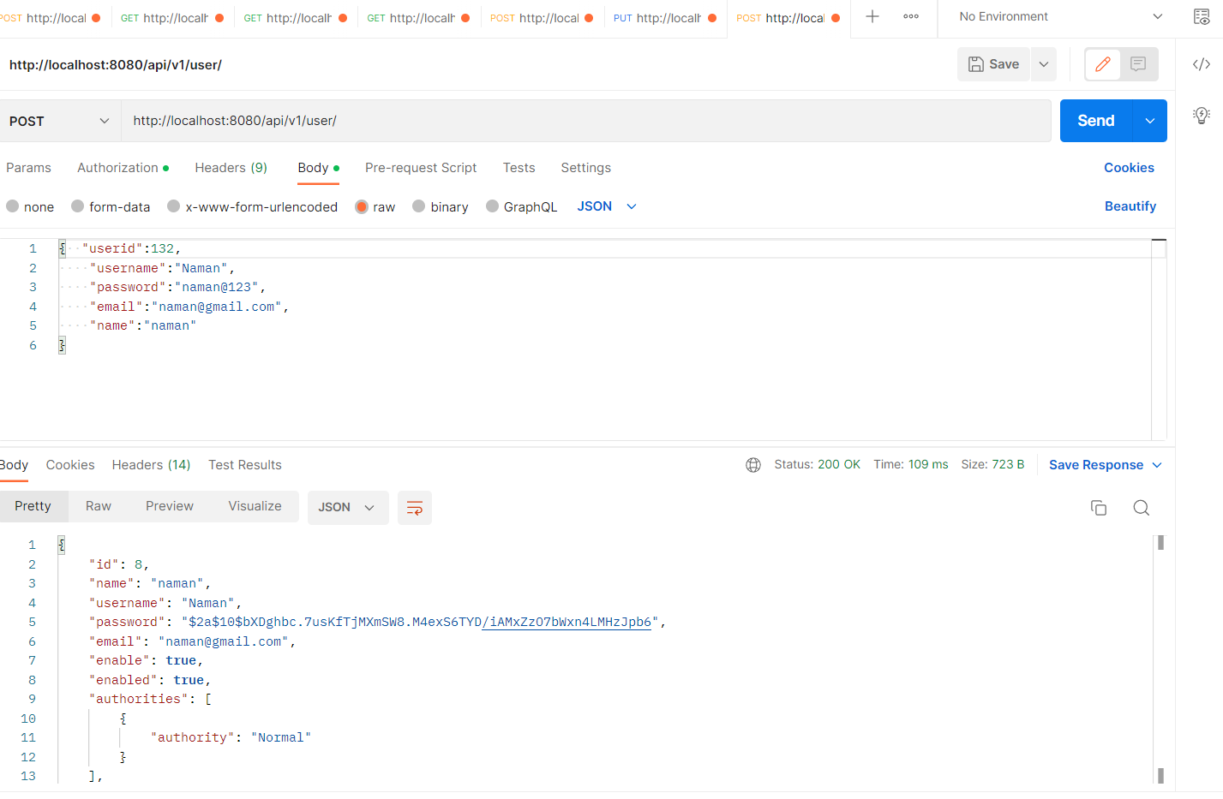
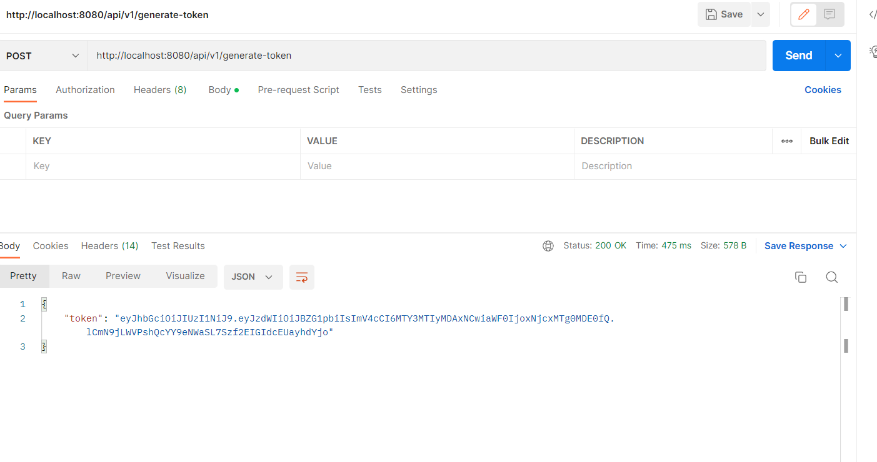
SIGNUP FORM API
Signup form API to get token and used to register user into the database
Input
10
© 2022 Cognizant | Confidential or Trade Secret

Slide 11
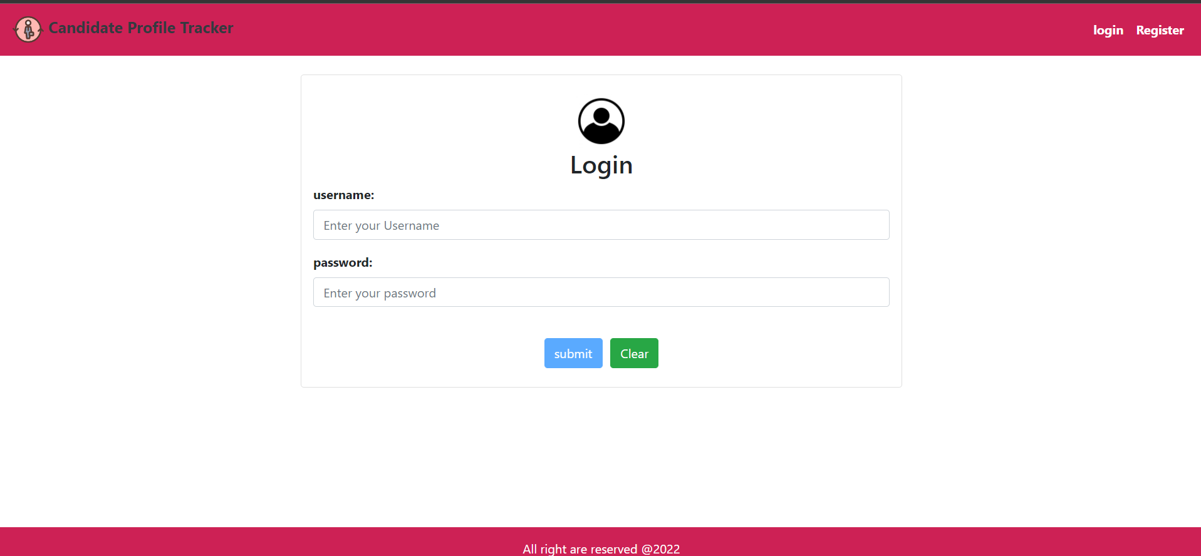
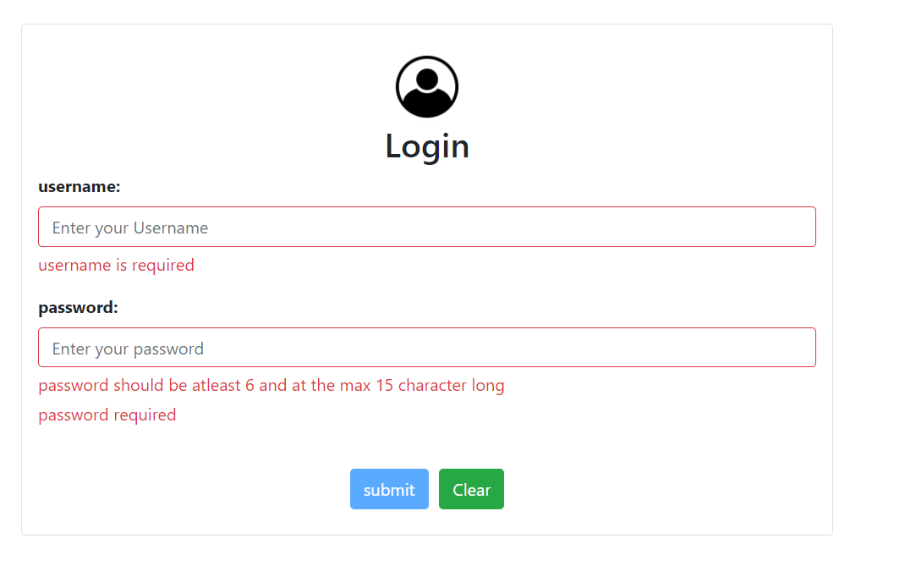
SIGN IN FORM UI
Sign in form consist of below fields:
Username.
Password.
Valid Username and Password must be provided for successful login.
After successful login, an alert box is displayed on the top by mentioning “User Successfully Signed”.
11
© 2022 Cognizant | Confidential or Trade Secret

Slide 12
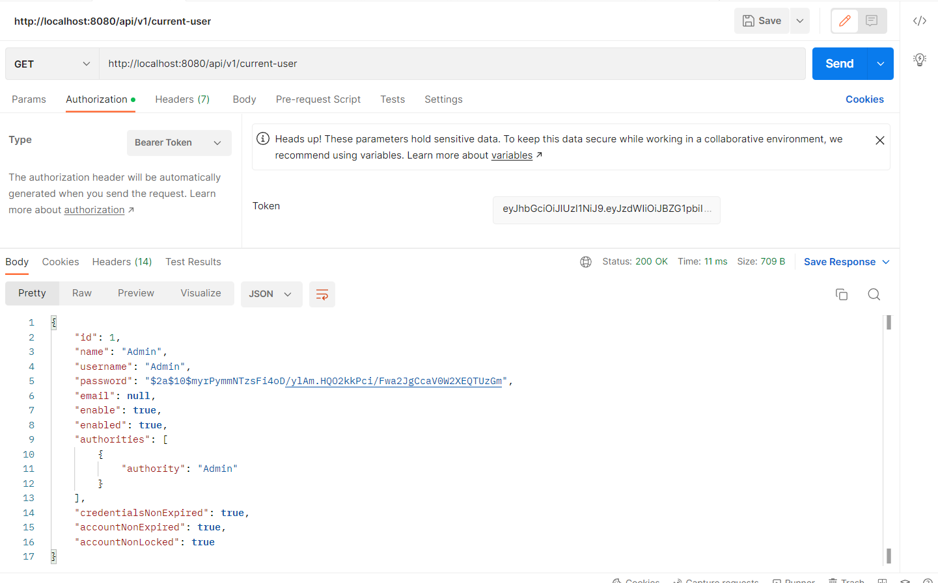
SIGN IN FORM API
Sign in Form API is used to authenticate the user for successful login
Input
12
© 2022 Cognizant | Confidential or Trade Secret

Slide 13
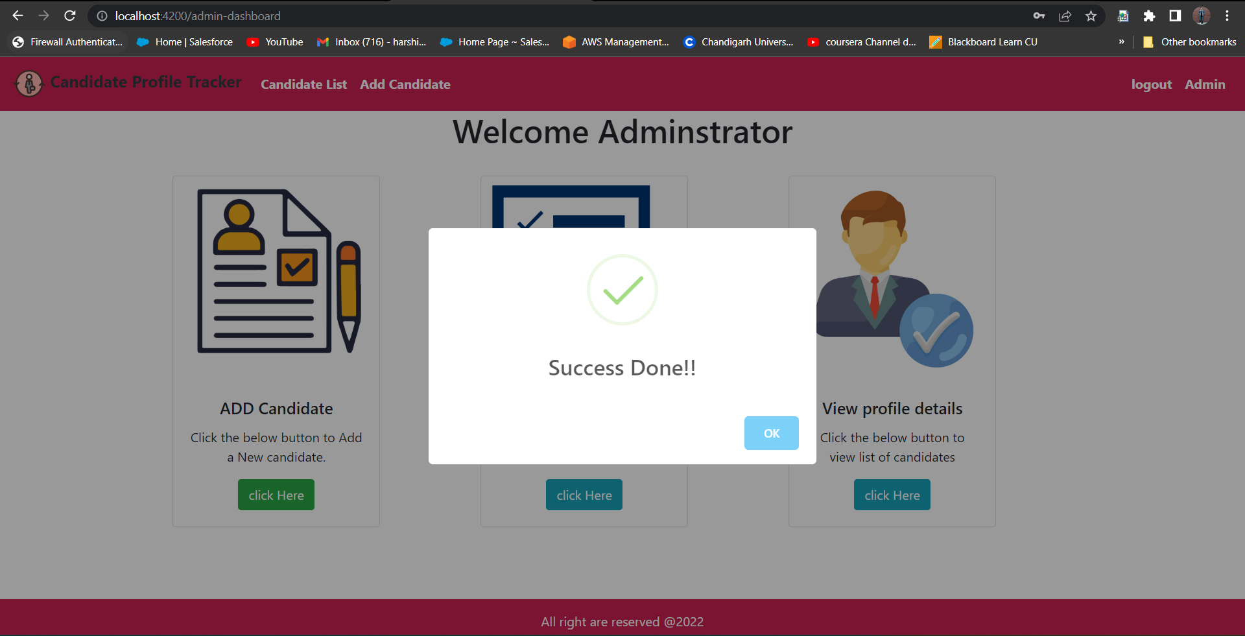
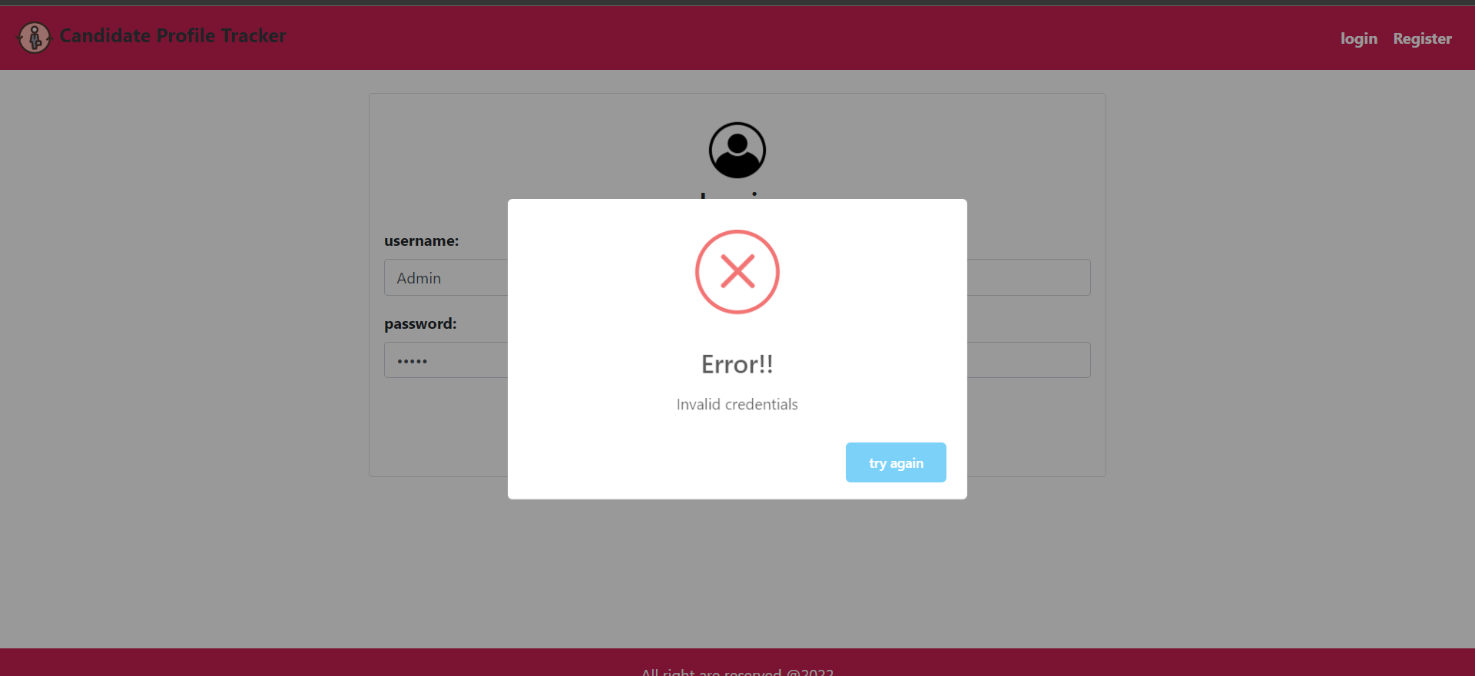
USER Dashboard UI
Once you login with correct credentials you will
redirect to Dashboard (Admin or normal)
If not then you will receive error prompt based of invalid credential from UI
Then you have access to the feature according to it
You can click on add Candidate card to add or new unique Candidate if you want .
Also you can we the list of all candidate present in it and modify it according to you
Also based upon role you update delete or view the resources if you want
13
© 2022 Cognizant | Confidential or Trade Secret

Slide 14
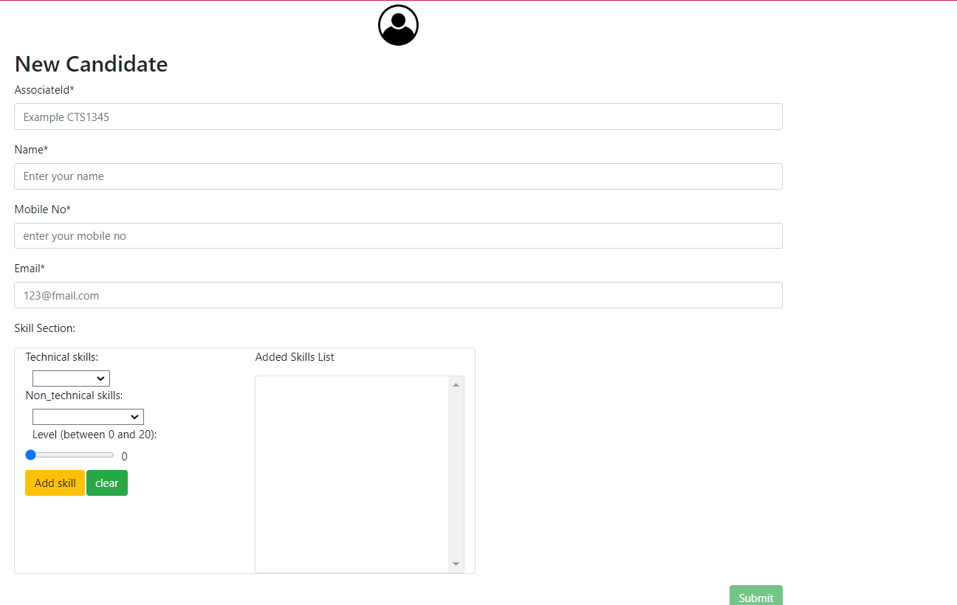
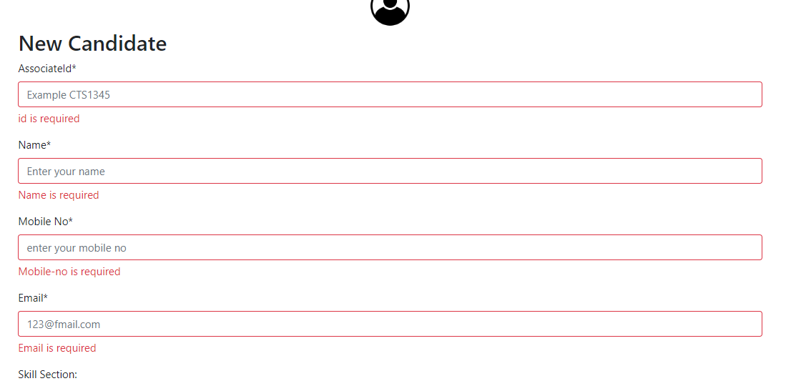
CREATE PROFILE UI
FIELD | CONDITION
Associate Name | Min 5 and max 30 characters.
Associate ID | Min 5 and max 30 characters Must start with “CTS”.
Email | Valid email pattern, containing a single @
Mobile | Numeric and Equal to 12 character
Skills | Single or multiple skill it have
MANDATORY FIELD
14
© 2022 Cognizant | Confidential or Trade Secret

Slide 15
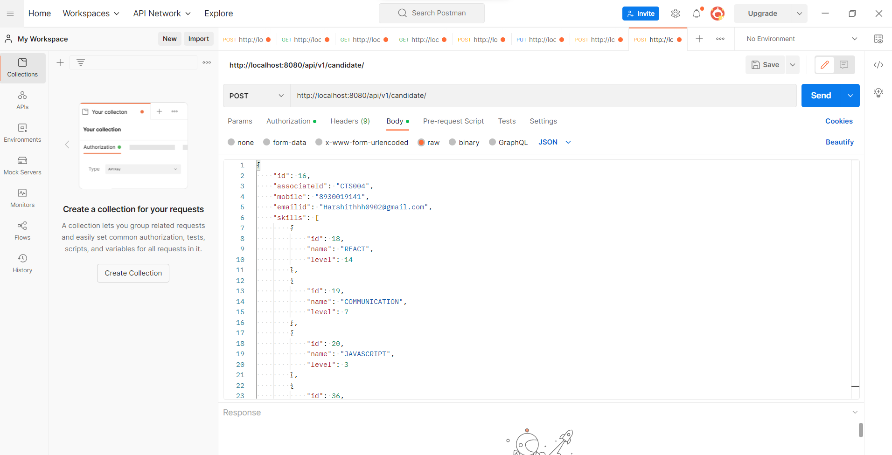
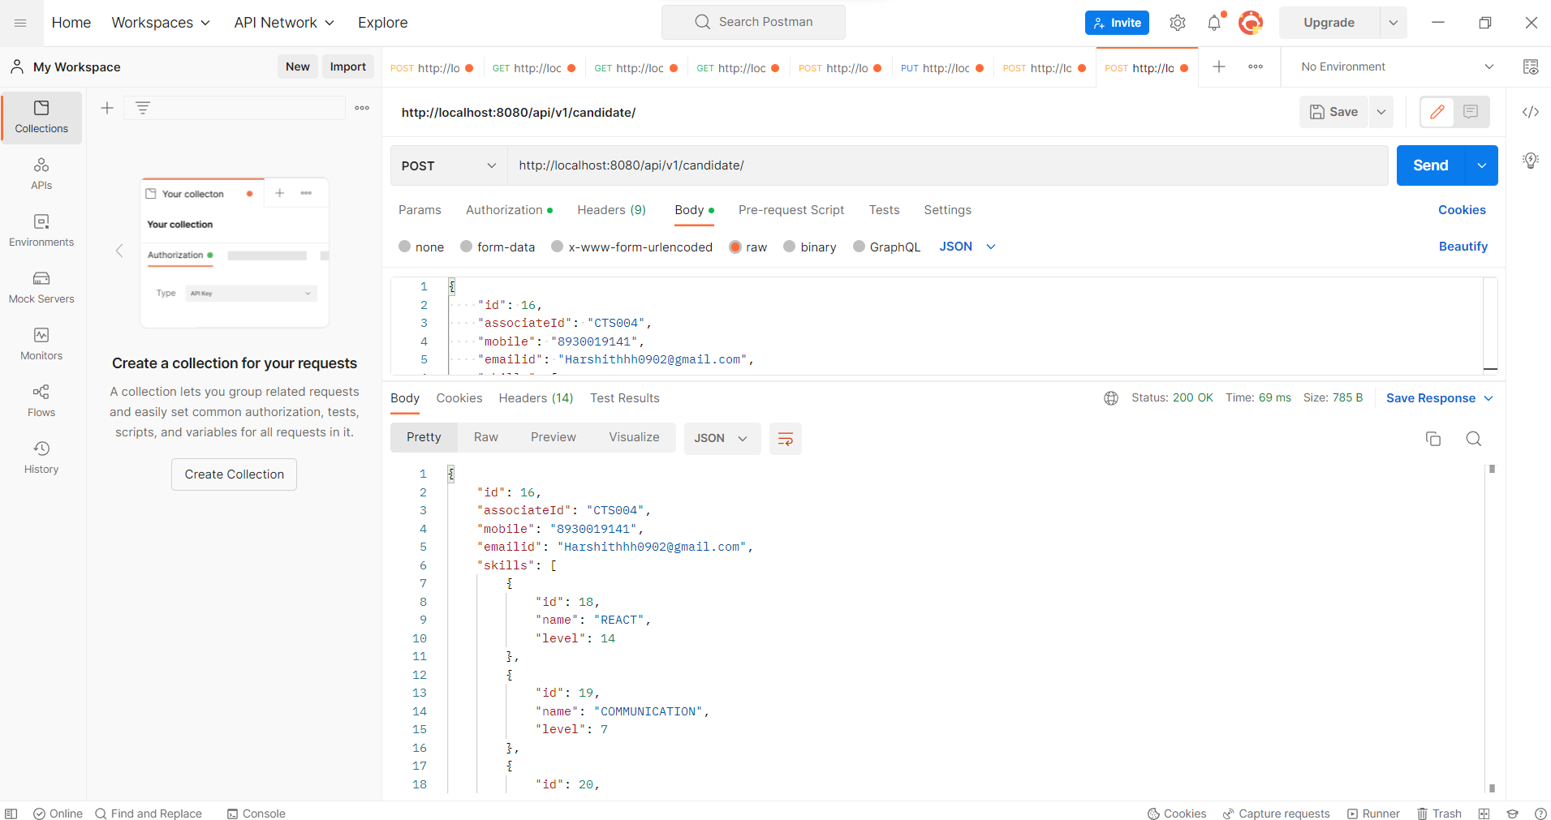
POST CANDIDATE PROFILE INFO TO SERVICE API
Create Profile Service application is used to add profiles into the database.
Input
Output
15
© 2022 Cognizant | Confidential or Trade Secret

Slide 16
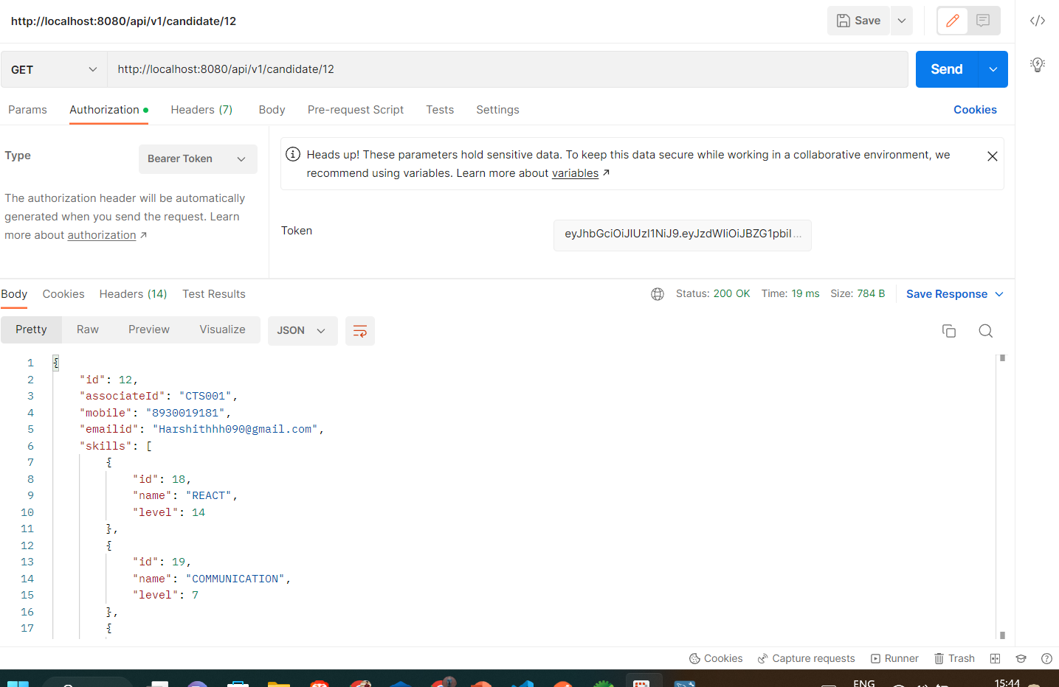
GET CANDIDATE PROFILE SERVICE API
Create Profile Service application is used to get profiles into the database.
Input
Output
16
© 2022 Cognizant | Confidential or Trade Secret

Slide 17
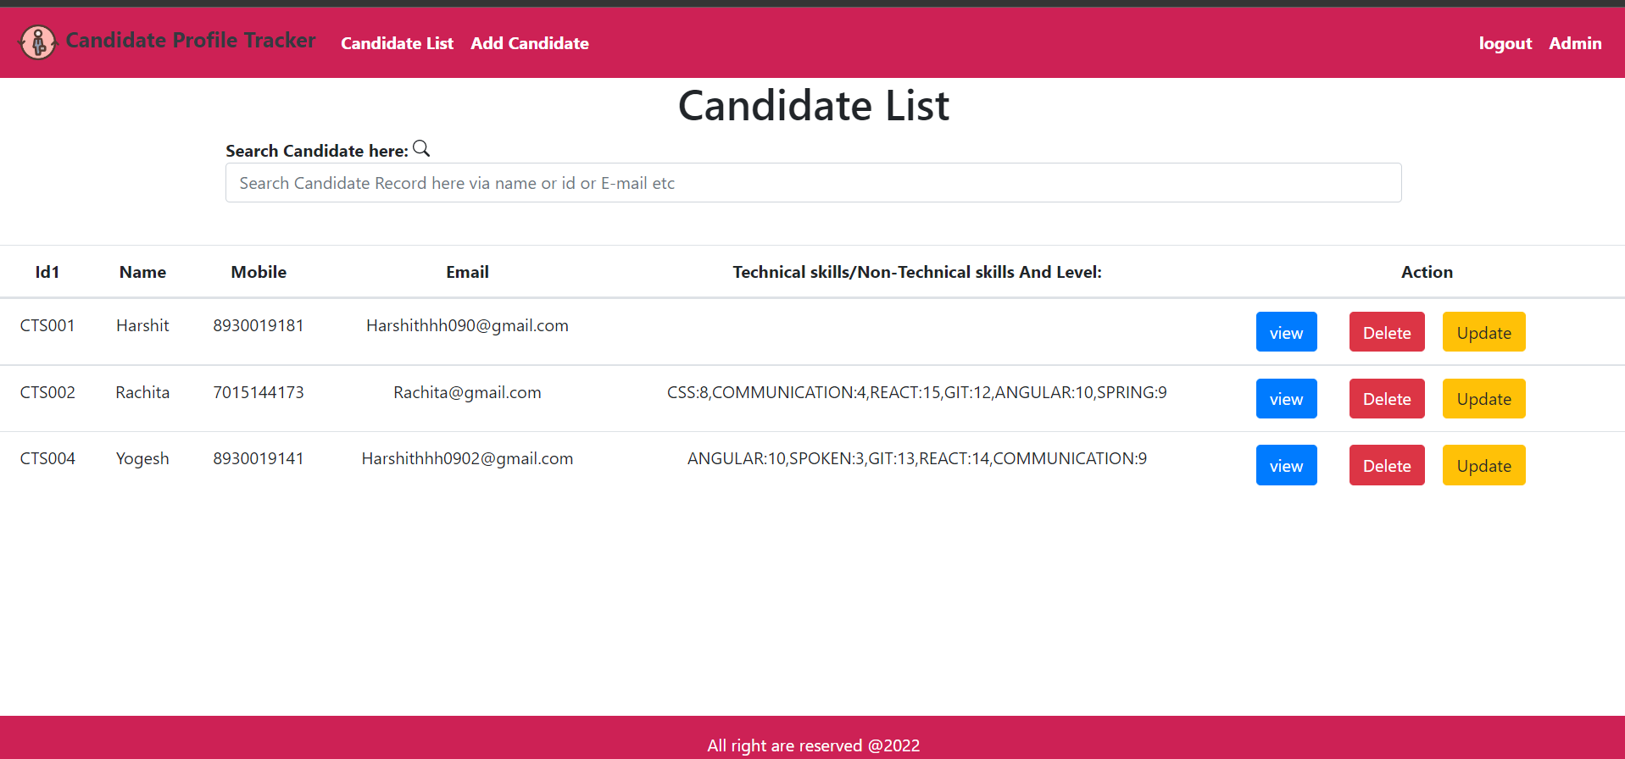
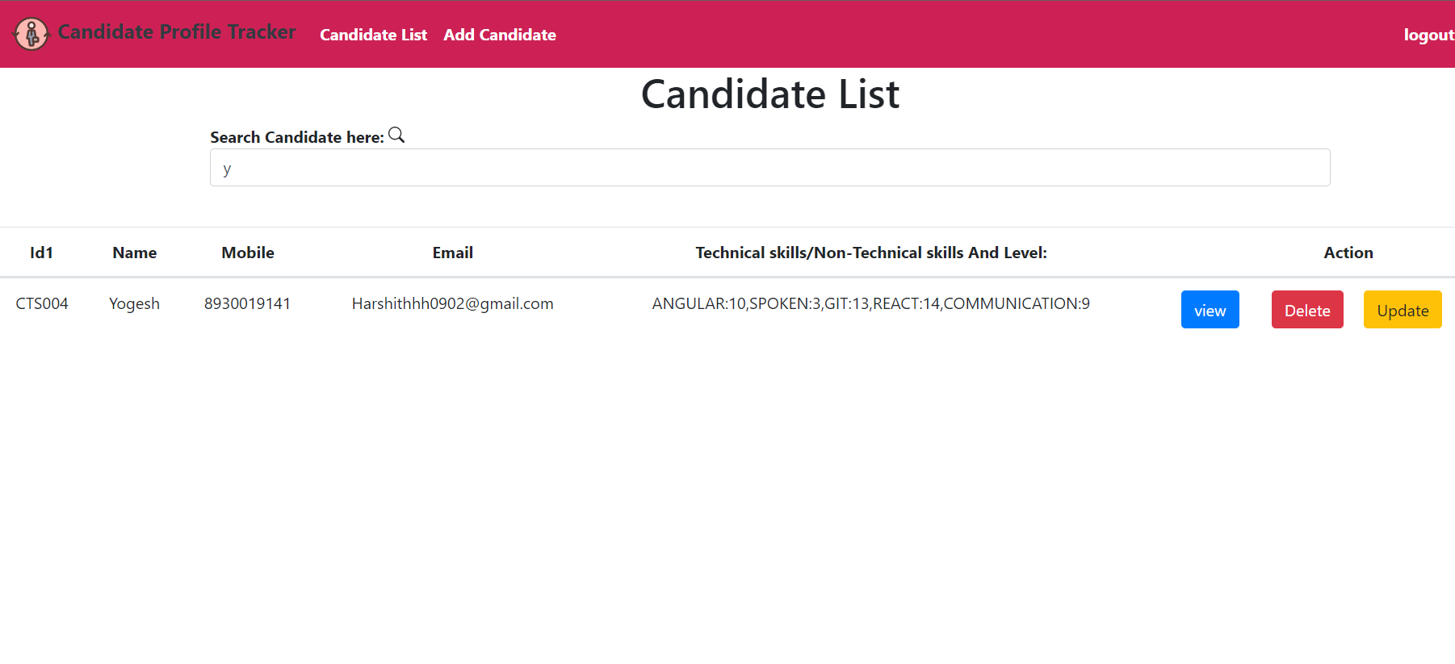
SEARCH PROFILE UI
Admin user have functionality to search
functionality to filter the record and also
update or delete if he want
normal user can update his record but
not even allowed to update or delete
another records.
normal user not even allowed to access
admin Dashboard as well.
normal user can only update his skill but
but not rest attribute but admin user
can update anything in it.
17
© 2022 Cognizant | Confidential or Trade Secret

Slide 18
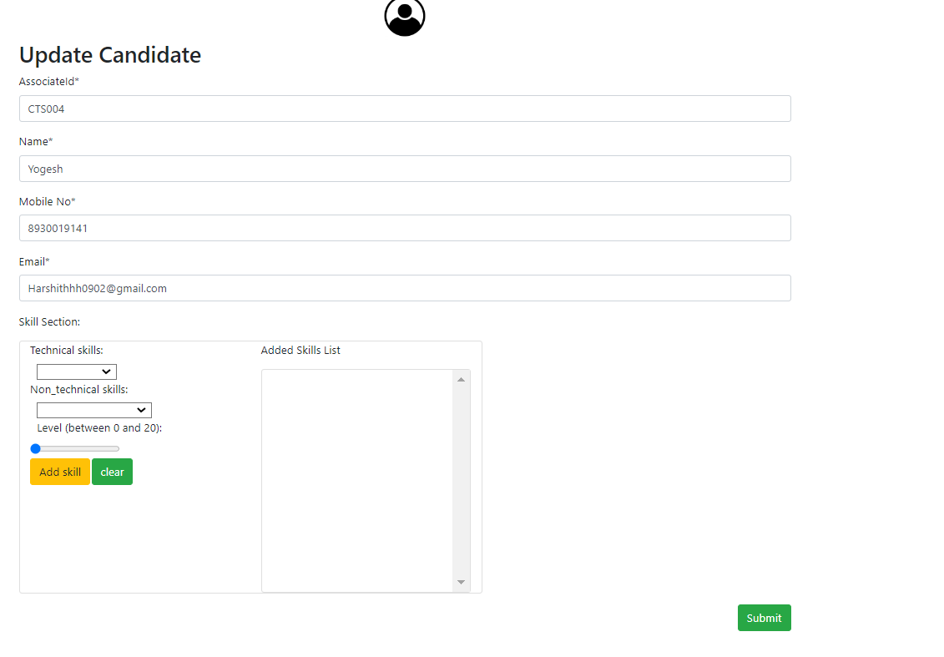
UPDATE PROFILE
Once you click on update button of any record
you will redirect to new page update page
and you can update any user if you admin
If you normal user can just update only your skills .
18
© 2022 Cognizant | Confidential or Trade Secret

Slide 19
Thank you

